Slide 1






How to get the best
from civic tech projects
Codifying our learnings
JD Bothma | 20 July 2020
Notes:
This title turned out much more lofty and ambitious than I intended. I don’t mean that this encompasses all kinds of civic tech projects. It doesn’t address all the challenges you will encounter on civic tech projects.
So what is this?
At OpenUp, we are always trying to work as effectively as possible. We have tried many different kinds of projects, different arrangements of people, and skill sets.
We each contribute different things based on our backgrounds and skill sets..
We also try to have regular retrospectives throughout a project’s life, to reflect as a team and stakeholders, to raise concerns, frustrations and issues, and then try small changes to how we work and see if they address those problems.
What often happens is that the problem goes away - perhaps because the change we made sorted it out. Perhaps because the team is now just aware of it. Or attention has shifted.
To be sustainable, and even scale up, we have noticed the need to make the things we do that we believe are key to effective projects more explicit.
Only when we are explicit about what we are doing, can we be sure to apply those learnings across projects, and even validate that those activities are really the things leading to success.
So this comes out of that effort of looking at a lot of the things our gut says we should be doing, or that have brought us peace when we’ve introduced them

Slide 2

Context: What does OpenUp do?
Our fears?
Key considerations
Tools and approach
Practical: try our approach
Recap
What’s covered

Slide 3
Who is OpenUp?
What do we do?

Slide 4
“
A South Africa where citizens and government are empowered to thrive, collaboratively
Vision

Slide 5
“
OpenUp seeks to empower people and government,
through data, technology and innovative-thinking,
to become active agents in creating positive social change.
Mission

Slide 6
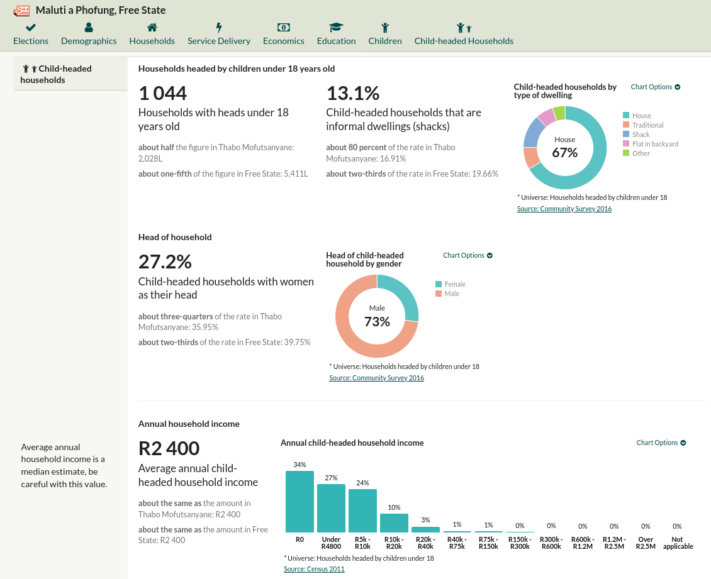
Wazimap
Accessible census data
Based on CensusReporter
No clear next step/action
wazimap.co.za/profiles/municipality-FS194-maluti-a-phofung

Slide 7
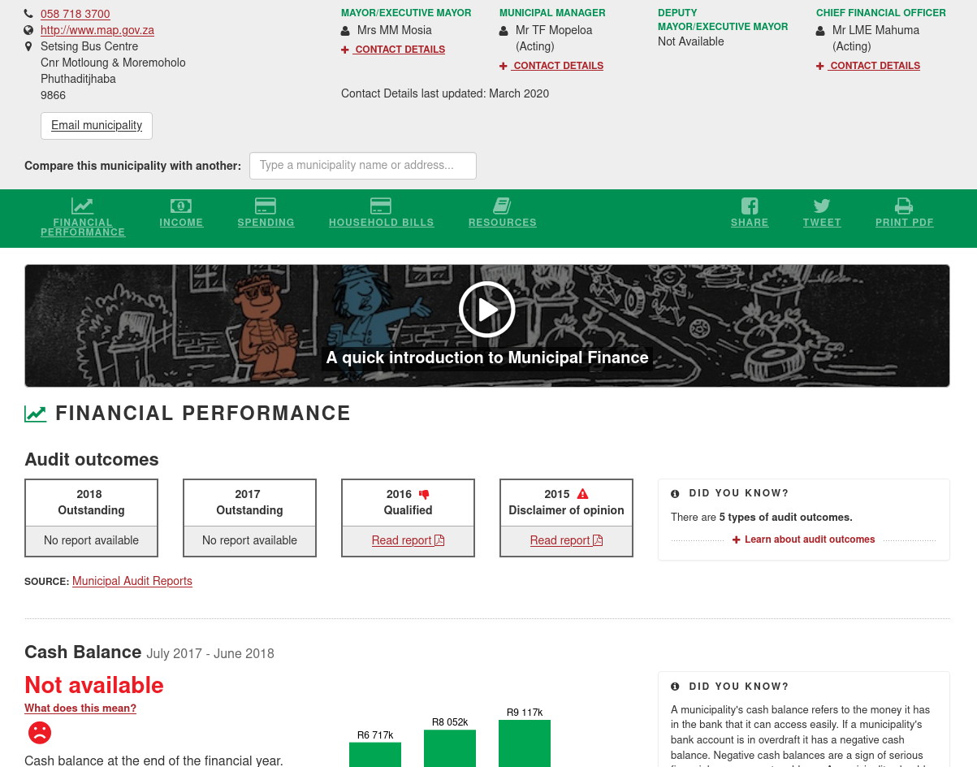
Municipal Money
Accessible fiscal data
Contact details for leadership
Easy to read indicators
Missing data is data
Next steps still unclear
municipalmoney.gov.za/profiles/municipality-FS194-maluti-a-phofung/

Slide 8
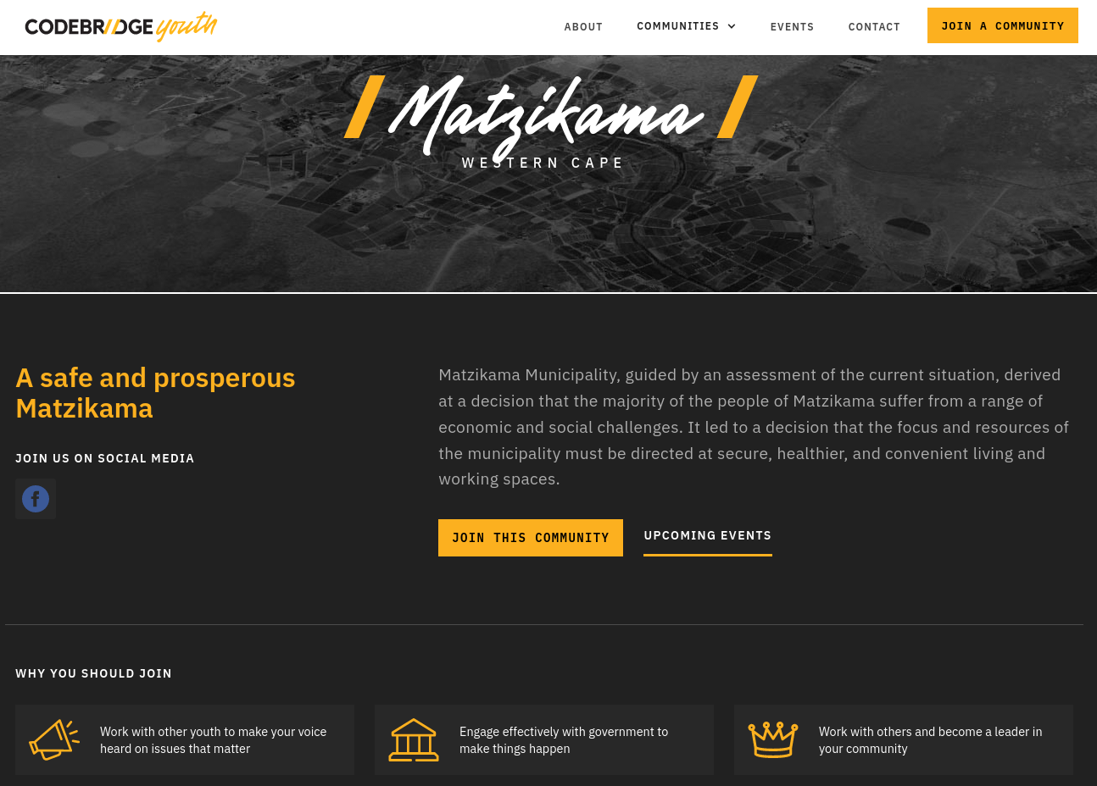
CodeBridge Youth
Civic participation groups
Meet where they are
Opportunity to upskill
Use existing processes
In collaboration with municipality
codebridgeyouth.org.za/communities/matzikama

Slide 9
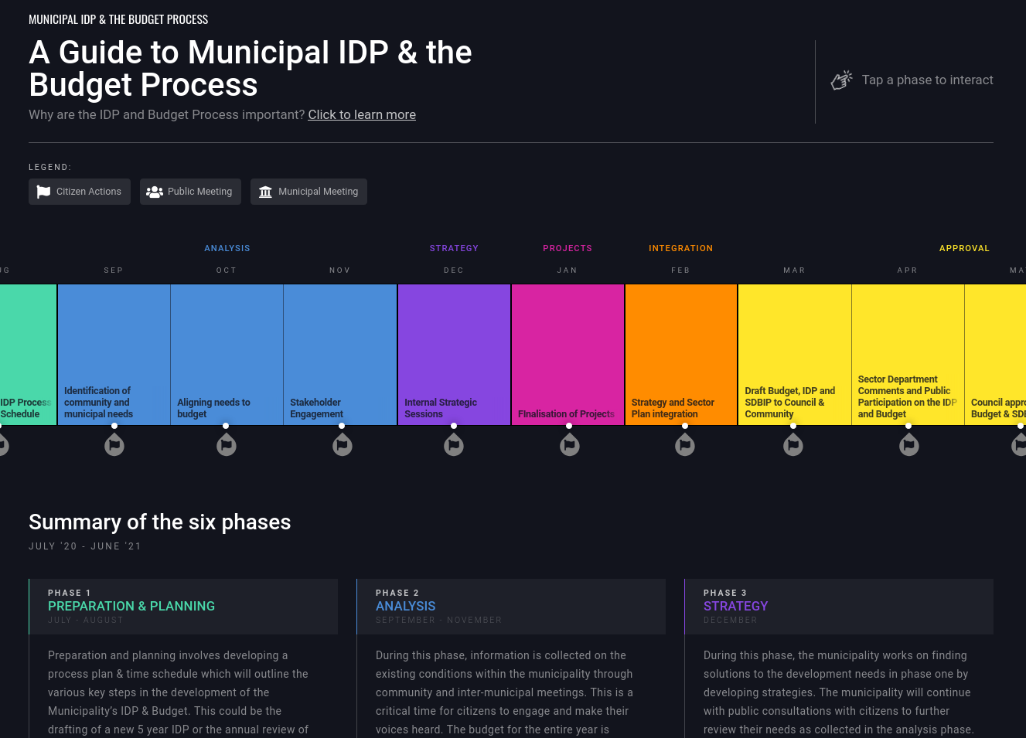
Local gov planning
Guide to the process
Participation opportunities
Legislated process
Specific meeting dates?

Slide 10
“
At least, that’s where we want to be.
Most projects should be experiments.
Success is learning
Notes:
How do we define success?
We are more upset about not knowing whether something has the intended effect, or not knowing why it does not have the intended effect, than we are about not seeing the intended effect.
Because by learning as quickly as possible what doesn’t work, and perhaps why, we can more quickly move on and try other things that would have the intended effect.
To be really honest with you, we’re really bad at this.
One reason is that it’s very easy to get caught up in the concrete everyday objective of the project - getting people to use it, just getting something we think is sufficient out the door.

Slide 11
OpenUp in numbers
Thumb-suck numbers, but gives the idea!
12
3
6
60
Core team members avg.
“internalised“ contractors avg.
Years
Projects (bigger than a 1-off data viz) 2-150 weeks each
3500
USD on coffee
Notes:
That might be one person working about 50% for two weeks, to three people working about 70% for three years.
Some of our projects are our own, and funded by grants we apply for.
Some projects are driven by other non profits, and either funded by grants they receive, or that we apply for together.
Some projects are with government, where we bid on a contract they are advertising. And we do that when there is an opportunity to do something in line with our vision, but as a standard service supplier winning a tender with government.

Slide 12
Context: What does OpenUp do?
Our fears?
Key considerations
Tools and approach
Practical: try our approach
Recap
What’s covered

Slide 13
We do something that already existed
We do something but it’s not used
We do something but it doesn’t solve the user’s problem
We do something but it doesn’t meet our objective
We start doing and it becomes too expensive
We start doing and it just doesn’t get finished
We just check the boxes on the contract
We don’t know if anyone’s using it or succeeding
Fears,
concerns,
failures
Despite the best intentions
Notes:
These are some of the things we worry might happen, and most of these have happened on one or more projects. We don’t want to repeat that.

Slide 14
Context: What does OpenUp do?
Our fears?
Key considerations
Tools and approach
Practical: try our approach
Recap
What’s covered
Notes:
Now I’m going to very rapidly touch on about 15 key considerations - things we believe should at least be in the back of someone’s mind when working on a project.
You don’t need to remember them.
The important thing is that you notice something that you didn’t think of before. That you weren’t aware was really quite important.
For us, it’s still not clear who owns each of these areas. Each team member will have multiple responsibilities. But the first step is just to make explicit that these things exist, and that they are important.
Once I have gone through these considerations we will zoom out a bit, and see how they might be grouped into broad areas of responsibility
It’s ok if you use different names for these things.
I’d love to hear what I’ve missed our, from your experience, what are the key things?

Slide 15
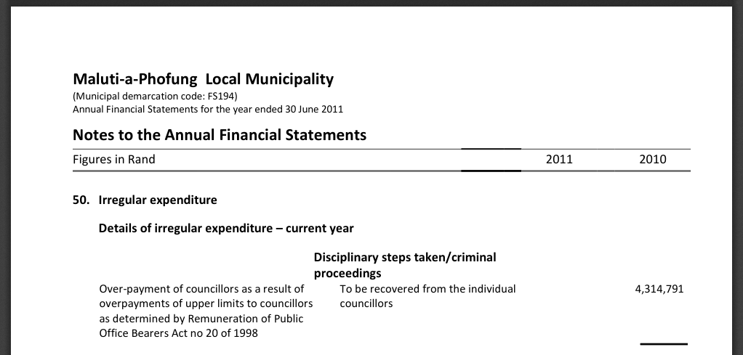
Domain knowledge
Do we know what we’re talking about?
Does a partner know?
Technical correctness
Annual financial statement
Notes:
Whether the project is about government finances, or about healthcare. Someone has to understand the field.
For example: Perhaps our accountant knows how to read annual financial statements.
Perhaps we do.
But do we understand the consequences for a local government being in a certain financial state? What mechanisms are available to address that?
Can we partner with someone who knows, if we don’t?
How will we ensure we are technically correct, and don’t mis-prepresent something subtle but important.

Slide 16
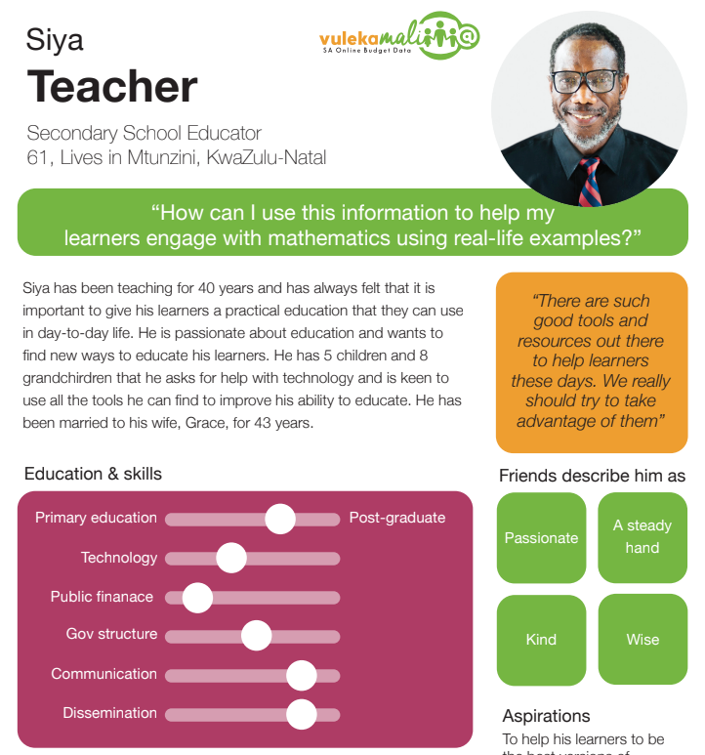
User research
Who’s relevant?
Who’s realistic?
What motivates them?
What is their goal?
Persona poster
Notes:
The people who would be interacting with whatever interventions we implement in a project - we need to have an idea who they are, what they are trying to achieve, what motivates them to take action, and how they fit into the bigger picture.
It’s also good to be explicit about the kinds of users your project is not trying to serve, perhaps because they’re just too hard to reach right now.

Slide 17
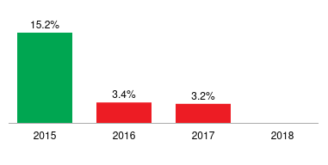
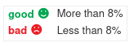
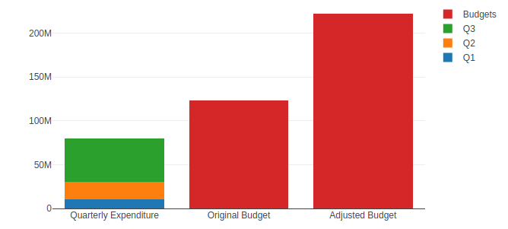
Visual design
Pretty! Usable?
Trust
Consistency
Visual language
Beware different meaning for the same colours
Notes:
Visual or aesthetic design is not just about your website looking pretty.
It can build trust in your tool for your users, for your client.
It can make interactions with your tool easier.
-------
We almost released a feature where we would use red for bars that really aren’t indicating something bad.
But on the core part of the site, we had established that green is good and red is bad.
But there are more subtle issues here as well. My eye isn’t as trained as our designer’s, but I’d bet the fonts are different. Clearly the spacing between labels are different. And a whole bunch more inconsistencies.
Now these are only charts. There is so much more - how you lay text out.
Some of this stuff might not make a noticable difference. We haven’t measured how much of a difference it makes. But we know there is at least an element of creating trust, when things look slick, or losing it, when things look unprofessional.
When things aren’t consistent, users are constantly figuring out what the things in front of them mean. Instead of learning it once and then only focusing on the things that are actually different features.

Slide 18
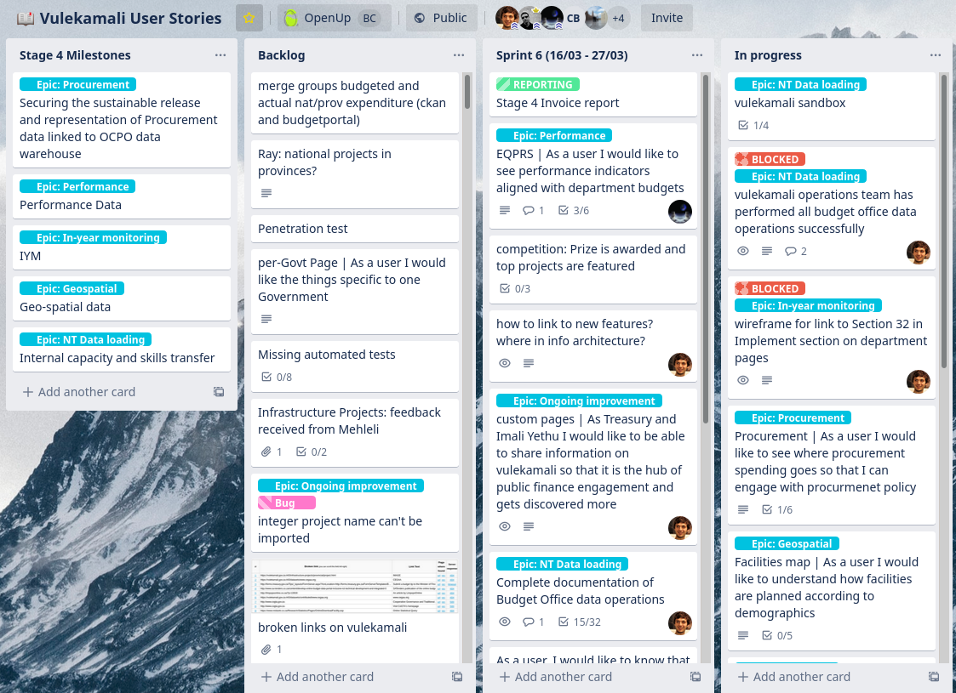
Track requirements
What is the priority of this?
Have we delivered that feature?
Do we all have the same idea?
Trello used to capture “User Stories”
Notes:
When I talk about tracking requirements, I mean actually writing them down, and then keeping them up to date.
What is the highest priority user need? What is not clear yet but might be worth looking at later?
It really helps to have something to point to when discussing a user need. Somewhere you can clarify what we mean by this need. Where you can write a note.
And who is responsible for keeping it up to date? For having the final say in what the scope is of a certain feature? What the priority is between two features?
--------
What is in scope, and for the important things that are out of scope, somewhere to note them.
And then some way of reflecting that addressing this one need or aspect, is more urgent or appropriate for this project, than these other ones. You don’t want to lose track of those other ones. You might have time to get to them.
In the end, you can have this wonderful asset of a list of needs identified through engaging with users, which could become the foundation of another project, or another phase.

Slide 19
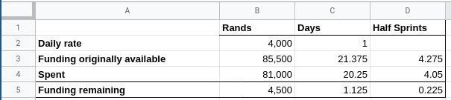
Administration
Have overspent the budget?
Are you underspending?
Meeting minutes, action items
Are you tracking anything?
An incredibly basic comparison of budget and actual spend
Notes:
Admin is for me the mind-numbingly tedious stuff. But when you realise how it enables the project and organisation to work effectively and sustainably, it becomes a cog in a pretty interesting machine.
It blew my mind when I learned that it can be really problematic if you underspend on a project. It’s not just overspending to watch out for.
In management accounting they say you can’t manage what you can’t measure. So if you’re not measuring things like money available and time spent each month, you’re probably not managing that money effectively.

Slide 20
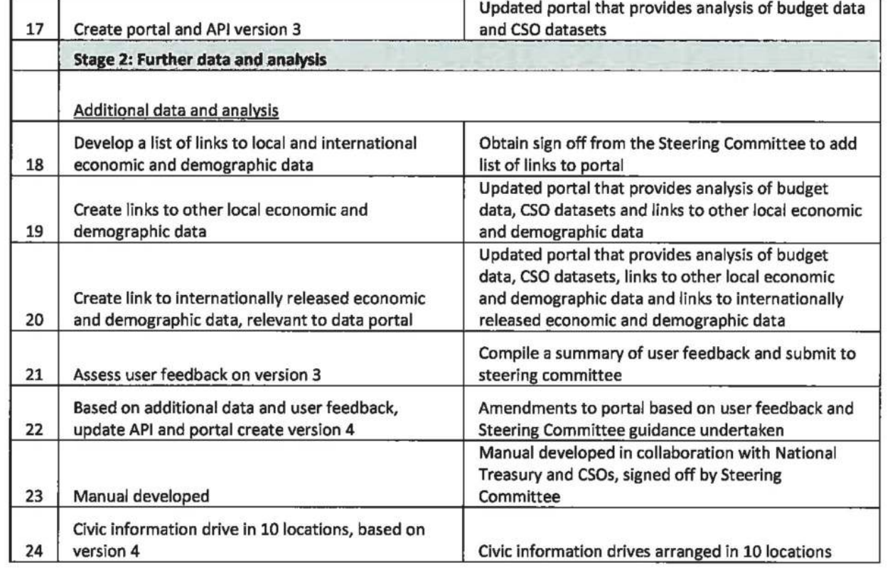
Compliance
Payment approval
Legal requirements
Grant, Contractual requirements
Vulekamali Terms of Reference
Notes:
While we try to focus 110% on the spirit of the problem we are looking to address, and what would be useful to actual users, you still need to adhere to any contracts on the project.
And legal requirements relevant to the project.
And internal processes of good governance.

Slide 21
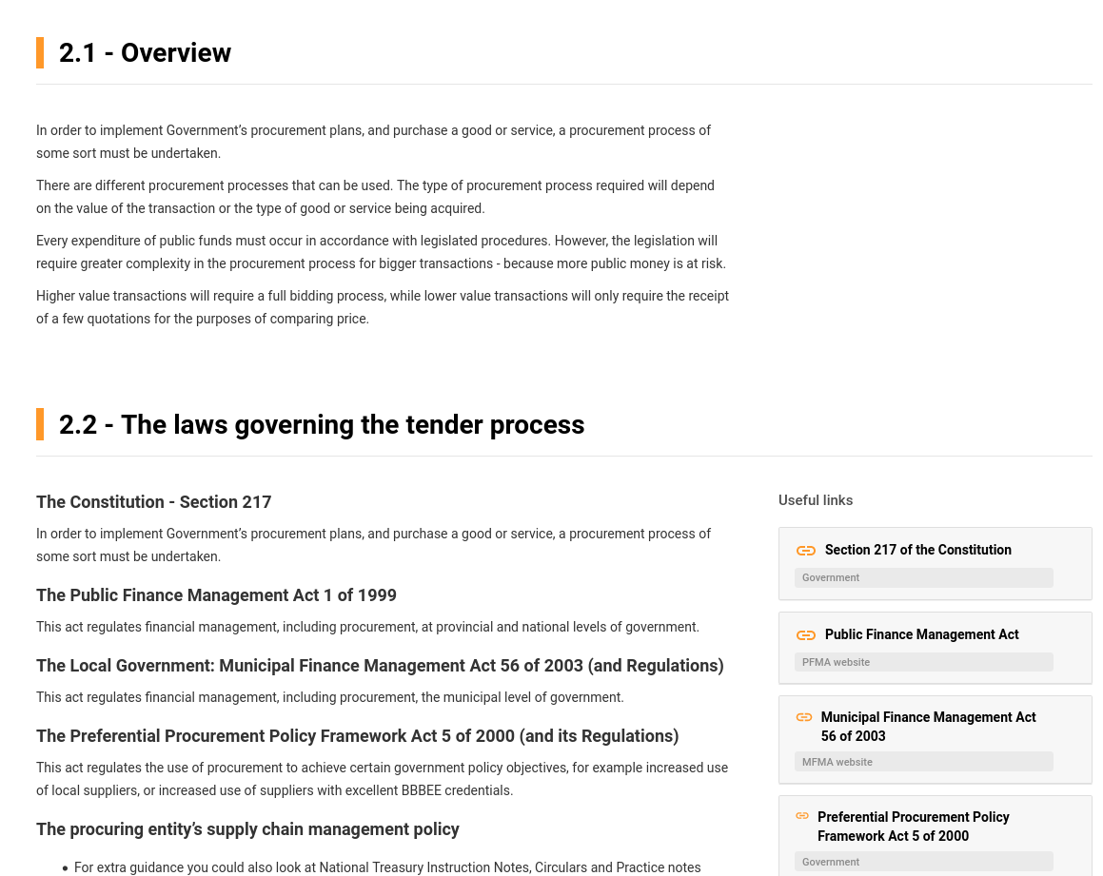
Create content
Guides
Tweets
Video scripts
Government procurement guide
Notes:
Someone has to create content. Unless you’re lucky enough to be able to copy it from somewhere and use it directly.
Someone has to do research, and find the structure, and compose that into content that fits together. Someone has to gather the correct links to additional resources and put them in the right place.
Someone has to condense information to the right length.
Someone has to write a video script.
Is this going to be a domain expert or a researcher? Is your programmer good at that? What will be most cost effective?

Slide 22
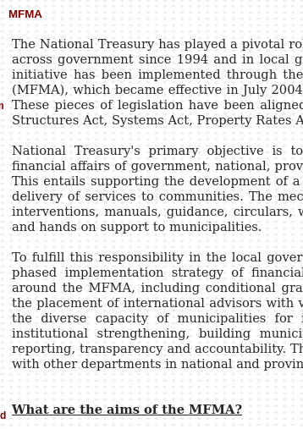
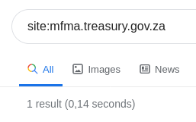
Medium expertise
Can you produce a video?
Can you use twitter effectively?
Can you put a booklet together?
MFMA website not in Google search results
Notes:
There’s more to publishing information than the words. There’s how you use visuals along with words. There are things very particular to the medium.
In this example, I show a government website, which is an incredibly rich resource, but for some reason it just doesn’t show up in google search.
If your medium is the web, you need someone who understands publishing to the web!
If you are making a video, someone needs to think how you tell a story with that medium.
Same for a booklet.

Slide 23
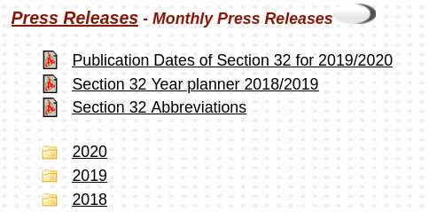
Write for the user
Language the user will understand Technical terms
Definitions
“Section 32” means “In-year reporting”
Notes:
You have to use language that the user will understand.
In this screenshot, the national government wrote “Section 32” referring to a section of an act which specifies in-year public reporting requirements. How many people know what section 32 refers to? So how effective can this public reporting be?
You want to catch your audience’s eye with what they are looking for. What they expect to see. You don’t want to scare them away.
At the same time, a lot of the time with civic work, the user will eventually have to use a technical term in their engagement with government.
So you can’t act like the technical term doesn’t exist. You might need to find a way to make a connection between the technical term and common language for the concept.
Also, if you are trying to help the more specialised audience with the same tool, you should be careful that it isn’t so basic that they think this isn’t relevant to them.
You need to be consistent on your site - make a decision - are you using the technical terms, are you using common language, and what is the system you use to help the user connect the two?

Slide 24
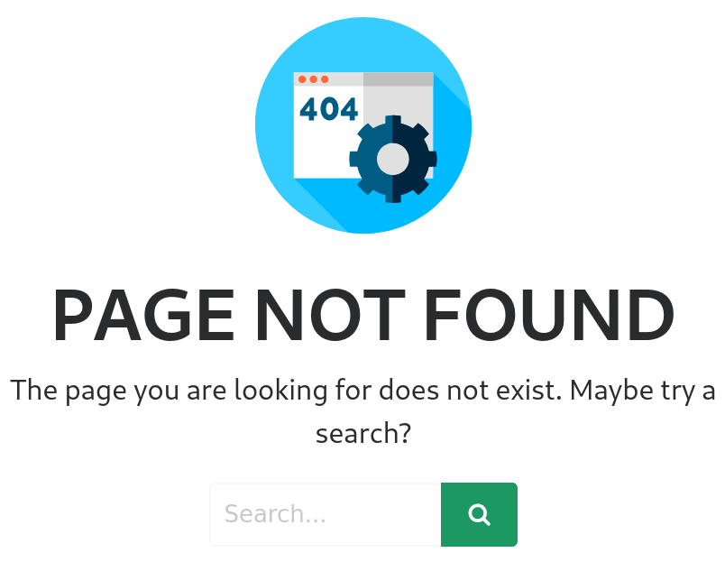
Technical leadership
What does tech offer?
What is the true cost? Incl Maintenance
How stable, scalable, expandable?
Is it still working?
Will anyone notice when it’s gone?
Notes:
For us, technical leadership is exploring how tech can help address a problem, and also when no-code or even non-tech things might be more appropriate. And we need to be aware of the hidden costs of writing code and using a lot of technology.
Bad decisions can have a significant cost. In industry, a fairly junior team is often given a massive amount of space to try and learn, but for us doing many small experimental projects, that has just proved unaffoordable. So we really prioritise having some senior technical person help make decisions.
They also understand hidden and long term costs, and the efforts needed to keep something running for a long time better than more junior people would.

Slide 25
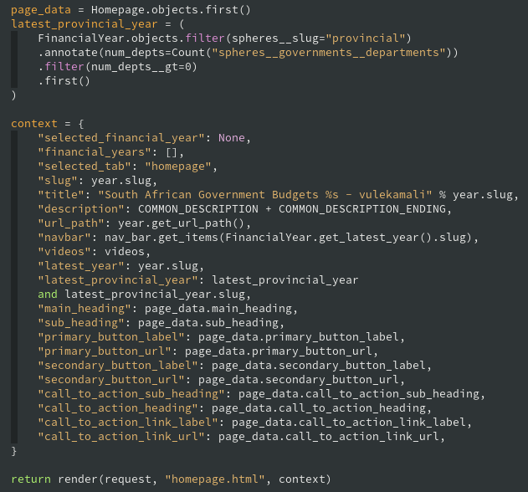
Implement! Deploy!
Frontend, Backend
Software code
Notes:
Of course if you do decide to build something new, someone has to build it.

Slide 26
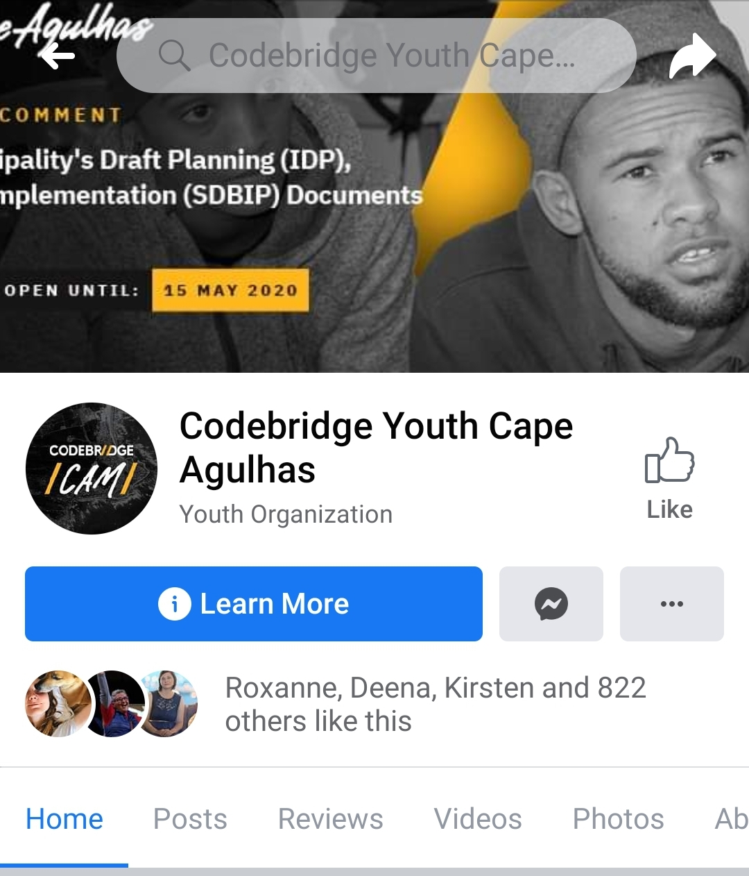
Community management
Respond to feedback
Relate with members
Facilitate discussion
Local community group facebook page
Notes:
Someone will probably have to talk to users if you have a community, and keep in touch to some extent. Is your software developer able to relate with the intended audience? Who in your team has the time to do this?
If you open that door, there’s the risk of putting people off when you don’t respond.

Slide 27
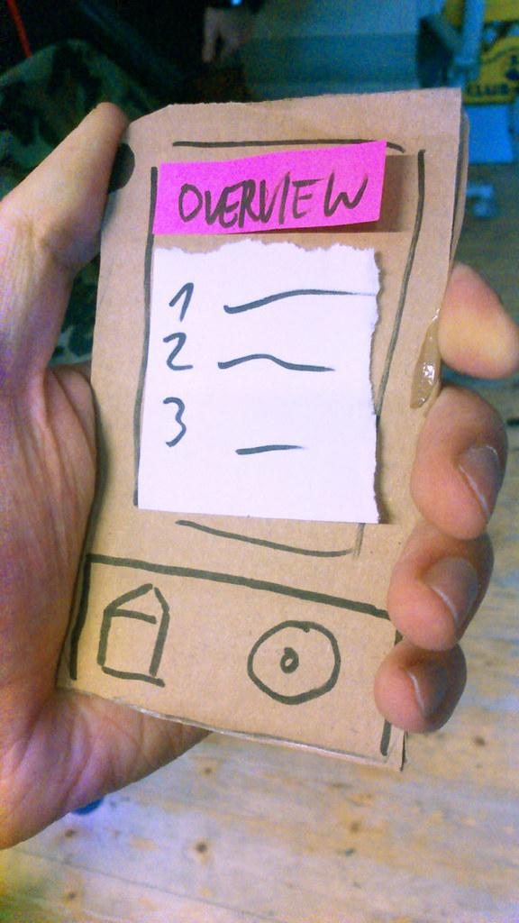
Testing, evaluation
Validate assumptions
Did you change anything?
For the better?
Do people complete their task?
Paper prototype
"Paperprototype_noProjectDemo" by d_jan is licensed under CC BY 2.0
Notes:
You can and should check with potential or actual users whether you are on the right track at every stage of the process.
You want to be doing this to discover that you’re probably not on the right track, that you’re making incorrect assumptions, as early as possible, and minimise waste.
-----
This image shows a paper prototype. You can validate assumptions and test ideas with users with very little actually built.
Paper prototypes have many issues, but if you’re careful how you test, you can still gain valuable insight - before you’ve built anything.
Testing with users is very sensitive to how the test is done - there is a lot of psychology involved. People might want to please you by saying “yes - this would be helpful” and still not use it when it’s built. People might want to impress you with their thorough critique, and actually what you had was fine.
Sometimes it’s more effective to build something that really works and get it out there.
Regardless of when you test and how, you still ought to get an idea whether you achieved anything.
And you should make an explicit decision about the scope of what you’re evaluating. If you’re trying to solve a bigger problem, you might want to know that you helped the user along a small part of their journey, but they are still not successful in their overall objective. Which might mean that your tool is a success, but your project is not.

Slide 28








Vision
Stakeholders
Users
Bring it all together
Lots of information
Lots of decisions
Vision vs reality
Team
Budget
Data
Backlog management
Notes:
Finally, someone has to ensure that all these things are considered in the project context. Someone has to hold the vision, and relate the vision to the reality of how much money and time is available.
Someone has to make overarching decisions of how to get to the vision.
Someone should care that all information in the various pieces of a project are is consistent, and that the project evolves in a way that different pieces don't become disjointed

Slide 29
“
Maybe not individuals
Maybe not experts
Just know what to consider
Notes:
These are a lot of considerations.
We certainly don’t have one person per thing.
We are certainly not experts in all of them.
But when we are explicit about the fact that these things are important to a project, we can see more easily where the gaps are.

Slide 30
Project definition
Project management
Domain knowledge
Compliance
Track requirements
Administration
Bringing it all together
User experience
Implementation
User research
Medium expertise
Non-tech
Tech
Writing for the user
Creating content
Technical leadership
User testing
Community management
Implementation
Visual design
Notes:
When I tried and group these considerations into something that makes sense to me, where I would go and ask someone to take care of the issue, these are roughly the groups I came up with.
The headings were added after the groups took shape.
It doesn’t matter if you would group things differently. In reality, when we have a team of 2.5 people, the responsibility for these considerations float around a bit, but it helps us to start talking about who would wear a certain hat, who we need to try and bring into the project, and we’re going to learn to do ourselves.
-----
By the way, this exercise of grouping a bunch of concepts according to how someone thinks they make sense is called a “card sort” - you can write these items on individual cards or postits, then ask the people who need to operate in the context where these things are relevant how they would arrange them. This allows you to see how you should structure content so that it matches their expectations, rather something that is technically correct, or something that meets your expectations, but not your user’s.
There are a couple of reasons why User Experience is not under the implementation heading. It doesn’t really fit under tech vs non-tech. It should permeate and perhaps be the connection between project definition and implementation. We realise more and more that it ought to be at the core of projects, while it might be one of the easiest things to neglect.
The activities that happen under user experience design are incredibly helpful for making the decisions that lead to effective projects.

Slide 31

Project definition
Project management
Domain knowledge
Compliance
Track requirements
Administration
Bringing it all together
User experience
Implementation
User research
Medium expertise
Non-tech
Tech
Lead Developer
Writing for the user
Creating content
Technical leadership
User testing
Community management
Implementation
Visual design
Notes:
So what has happened to us a lot, is we would stick a developer on a project, thinking this is a smart person. They’ll figure it out.
The shading represents the neglect of these considerations.
I made the project definition, user experience and visual design crosses a bit softer than the non-tech and project management crosses, because I like to consider myself a well-rounded developer.
But it’s really really hard to switch between the big picture, bringing it all together, and deciding how to structure the data in the database, how to connect this system to that in a robust way. How to handle missing data.
I also made the shade across visual design a bit smaller, since there are tools we non-visual developers can use to make things look pretty without knowing much about design. But it’s still pretty bad.

Slide 32
Project definition
Project management
Project manager
Domain knowledge
Compliance
Track requirements
Administration
Bringing it all together
User experience
Implementation
User research
Medium expertise
Non-tech
Tech
Lead Developer
Writing for the user
Creating content
Technical leadership
User testing
Community management
Implementation
Visual design
Notes:
If you add a project manager to the mix, at least that stuff should be taken care of. And now someone is able to hold the big picture while the techie is deep in the details.
Much better, but there are still big gaps.

Slide 33
Product owner
Project definition
Project management
Project manager
Domain knowledge
Compliance
Track requirements
Administration
Bringing it all together
User experience
Implementation
User research
Medium expertise
Non-tech
Tech
Lead Developer
Writing for the user
Creating content
Technical leadership
User testing
Community management
Implementation
Visual design
Notes:
The name we give to the person responsible for the projedt vision, bringing everything together, defining the project, is the Product Owner.
The term comes from the Scrum methodology which is usually about software products. But really it can be applied to any kind of project. I will talk more about the role in scrum in a moment.
The product owner might be the project manager, but they probably shouldn’t be part of the implementing team.
Adding a product owner, you should see more attention coming to the remaining considerations, but unless they possess those skills, and sufficient time, those considerations are not completely solved until they’re delegated to someone competent.

Slide 34
Defines product vision
Represents user needs
Maximise value resulting from team’s work
Define deliverables
Prioritising, ordering deliverables
Product Owner
A role in the Scrum methodology
Notes:
I will touch more on the scrum methodology at the end, but I want to touch on the fundamentals of what a product owner is. Someone on your team might already be doing these things. We find it helpful to have a name for it.
You don’t have to be building a product.
The role is about defining the vision of a project, what you want to achieve, understanding the problem space, and making decisions that maximise the value of work done. That’s it. So it applies very much to the civic tech space.
And I know this role exists in other spaces as well. We use scrum because it brings some great approaches for working and communicating effectively inside the team, and with other stakeholders.
-----
We have seen that some people really struggle with the distinction between a product owner, a project manager, perhaps a boss, or the big cheese. Sometimes ego gets in the way.
Let me tell you, I don’t want to be a product owner. You have the ultimate responsibility for maximising the value of the work done. That means it’s up to you to ask the right questions, or ensure that the right questions are asked.
The scrum methodology where this role definition comes from is very much about responsibilities, not hierarchy, and I think you should really embrace that view. As a techical person, I have the responsibility to advise the product owner on the tradeoffs of potential implementation options.
If they take that information and make a bad call, that’s on them. While I might stress about them making the right call because I care about the outcome of the proejct, it’s actually libirating to know that that resposnibility doesn’t rest with me. I should lobby them as accurately and clearly as I can, and then it’s up to them. If that’s the view the whole team takes, you end up with a much healthier dynamic than when you see the product owner as the boss.

Slide 35
Product owner
Project definition
Project management
Project manager
Domain knowledge
Compliance
Track requirements
Administration
Project administrator
Bringing it all together
User experience
Researcher
Implementation
User research
Journalist
Non-tech
Tech
Lead Developer
Medium expertise
Community manager
Writing for the user
Creating content
Technical leadership
Developer
User testing
Designer
Community management
Implementation
Visual design
Notes:
There’s usually a range of other non-tech implementation work.
Researchers and journalists have contributed a lot to our projects.
We haven’t really had explicit community managers, but we are beginning to do that a little bit, and learning what’s needed there.

Slide 36
Product owner
Project definition
Project management
Project manager
Domain knowledge
Compliance
Track requirements
Administration
Project administrator
Bringing it all together
UX Designer
User experience
Researcher
Implementation
User research
Journalist
Non-tech
Tech
Lead Developer
Medium expertise
Community manager
Writing for the user
Creating content
Technical leadership
Developer
User testing
Designer
Community management
Implementation
Visual design
Notes:
The person who truly understands user experience is often called a user experience designer.
We have only brought someone like that into a project on a few occasions, sometimes because we had fairly good coverage of that role in the team members, and sometimes out of neglect. On occasion we’ve realised quite late that there isn’t an awareness in the team of this field, and that someone has to pay attention to it, until late in a project
-----
I learned this card sort trick from a user experience designer.

Slide 37
Considerations
Roles
What have I missed?
Your experience
Notes:
What are some considerations or roles I’m missing out here, from your experience?
-----
In the chat or via voice, just say or write “Consideration: ...the thing... “ or “Role: ….the thing...” and I’ll add them here

Slide 38
“
Maybe not individuals
Maybe not experts
Just know what to consider
Notes:
These are a lot of considerations.
We certainly don’t have one person per thing.
We are certainly not experts in all of them.
But when we are explicit about the fact that these things are important to a project, we can see more easily where the gaps are.

Slide 39
Context: What does OpenUp do?
Our fears?
Key considerations
Tools and approach
Practical: try our approach
Recap
What’s covered

Slide 40





A project process
What’s the state of the world?
Intended outcome
Who is involved?
Build and try
Evaluate
Information architecture
Build and try
Evaluate
Build and try
Evaluate
Project vision & objectives
Personas
How could users succeed?
Wireframe, Design system, Mockup, MVP and iteration
User testing results,
client feedback
Storyboards, user journeys & user stories
Notes:
The dark blue represents steps in the process.
I just made up these names as I’ve been discussing this with my colleagues and trying to document it. There are probably better terms for this, and you’re welcome to tell me so later.
This process chart was derived, not invented. It very much represents other standardised approaches to project management. I’m just using it as a vehicle to discuss how things fit together.
The lighter boxes represent outputs, or artifacts, things we produce that we or users can use.
I won’t go into detail on how each is produced. Please google the. They are actually technical terms used in the software and user experience design space.
On the next slide I do have some questions that help explore these areas a little bit.
The rough idea here is that you start with clearly defining the intended outcome. You define a project vision and set objectives.
You then look at who the people are that are involved or affected by this vision. Potential users, decision makers, data owners.
Next, you want to understand the state of the world. What already exists to address this problem? What can you build on?
At the same time, and perhaps in conjunction, you can consider how users could succeed - what mechanisms exist to effect change?
Finally you can build something. Or try doing something. Some basic version of your intervention. And see how well it works. And see if you need to adjust your ideas a bit and try again, or if you can just scale up.
And I don’t mean to say you are only speaking to end users at this evaluation step. You should be validating your ideas with people in the real world, outside your bubble, all along the process.
It’s also ok to go back and update as you learn. But you should especially have a strong loop of building something small, getting it out to real world users, learning, and building on top of that, on and on and on.
The point here is that it’s worth doing some homework first. Giving your project a nice foundation to build on. So you don’t have to ask these questions in every build/evaluate iteration.
-----
If the strategic leadership of the organisation is already doing this, but it’s not written down, and only half of it is communicated verbally to the project manager taking the project on, it may as well not have happened. And I’ll show an example of that in a few minutes.

Slide 41
What’s the state of the world?
Intended outcome
Who is involved?
Information architecture
Build and try
Evaluate
What data is available and is it ready to use?
Build and try
Evaluate
Build and try
Evaluate
Project vision
Personas
What information is out there?
Project objectives
Stakeholders
What mechanisms exist?
What do we want to achieve?
What motivates your users?
Wireframes
User testing results
Mockups
What tools do they use?
How could users succeed?
Client feedback
Why do we think our idea will achieve that?
Design system
What do they know?
What do you understand from what you see here?
Should we help our client with this stage?
MVP
How educated are they?
Storyboards
Iteration
What do you not understand from what you see here?
User journeys
What is the smallest thing we could do to validate our idea?
User stories
What have we misunderstood?
Where are your users located?
What is the core of this feature? What can wait?
How did they find our work?
What are all the steps involved?
Notes:
I want to go through these questions quickly, because they are helpful in a project, and also to understand what we mean by each step.
Of course the degree to which you do this depends on the scale of a project. For a two week project, it might be some notes and/or sketches. You can treat each artifact like a heading in a document.
For a two year project, each deliverable might make more sense as one or more document, documenting background, methodology, and perhaps they’re presented in a visually accessible way for the team easily use for reference.

Slide 42
Vision
Mission
Objectives
Outcomes
Activities
What’s the state of the world?
Intended outcome
Who is involved?
Build and try
Evaluate
Build and try
Evaluate
Build and try
Evaluate
How could users succeed?
Notes:
If you come from the NGO or project management world, this probably isn’t new to you.
It aligns very well with vision, mission, outcomes, objectives, activities, but with very clear notion of iteration during implementation.

Slide 43
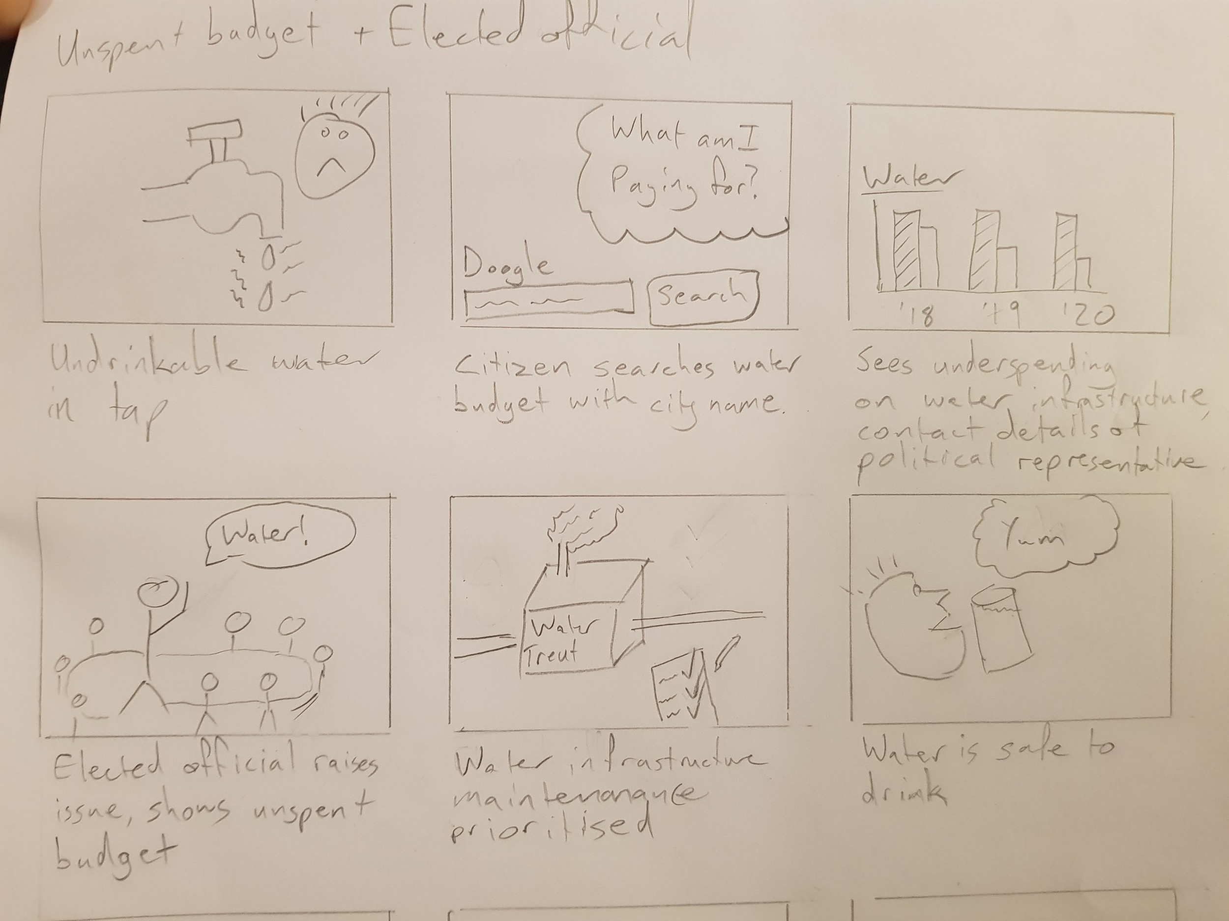
Storyboard
A note about design
scope
Notes:
And don’t think the scope of this process is just your app idea. I want to quickly introduce storyboarding to nail this issue on scope.
Here we have a storyboard for our local government finance project. Let’s go through the frames very quickly.
Start at a trigger event - the water is undrinkable

Slide 44
Storyboard
A note about design
scope
Notes:
Ends with a positive outcome - water is drinkable

Slide 45
Storyboard
A note about design
scope
Notes:
The issue is water infrastructure in disrepair

Slide 46
Storyboard
A note about design
scope
Notes:
Budget and spending data can show that there is money allocated for this infrastructure but it’s not being spent.
The database of local public officials and elected political representatives can show who could be petitioned about the issue.

Slide 47
Storyboard
A note about design
scope
Notes:
An elected official who now has data at hand can raise the issue and get to the bottom of the underspending and disrepair

Slide 48
Storyboard
A note about design
scope
Notes:
Remember to think about how users will get in contact with your intervention. This depends on who you are targeting. If it’s a web thing, you need to use terms that will lead users to your site via search engines or their networks.
-----
What are the gaps between the trigger event, your intervention, and the positive outcome?
What mechanism exists for the user to take an action that you have some confidence would lead to the successful outcome? What actions do the users need to take? Do they know they exist? Do they know how to use them?
This is why the scope of this way of looking at a project spans right from the problem, through to what success looks like. And your actual direct intervention is just a little step in a series of things that need to happen.
You will benefit from looking at them to make the process as smooth as possible. It’s valid to say that you’re not going to fix the political process, or internet access. But if all of your ideas are dependent on things around you that don’t actually work, you’re wasting your time and should look elsewhere.

Slide 49
Time and money
What’s the state of the world?
Intended outcome
Who is involved?
Build and try
Evaluate
Build and try
Evaluate
Build and try
Evaluate
How could users succeed?
BUDGET
Time
Notes:
Using our process chart, then,
We can plot the project budget over time, and see that talking and asking questions and doing research costs time and money. The line goes down a little bit
We can see that a number of iterations of building and maybe even evaluating also costs time and money, and we show a compressed time scale here

Slide 50
Forgetting evaluation
What’s the state of the world?
Intended outcome
Who is involved?
Build and try
Evaluate
Build and try
Evaluate
Build and try
Evaluate
How could users succeed?
BUDGET
Time
Notes:
If you forget evaluation, your budget keeps going down, and maybe you come to the end of your budget and think oh! Let’s evaluate and see what we’ve achieved so we can report on it.
Your time and budget is finished. You can’t improve on it. Learning and improvements have to be applied in a different project, or a second phase.

Slide 51
Starting at building
What’s the state of the world?
Intended outcome
Who is involved?
Build and try
Evaluate
Build and try
Evaluate
Build and try
Evaluate
How could users succeed?
BUDGET
Time
Notes:
A lot of the time, we want to jump right into building something.
If you have a client, people get so wound up getting contracts written, agreed, signed, clients ask “when can you get something done?” so you start making promises about getting something done in the next few weeks.
Don’t forget, the deliverables of the earlier steps are completely valid deliverables. If you write them down clearly, and make them easy to find and understand, they are tangible deliverables that are laying the foundation for working effectively for the remainder of the project. Treat them that way. Let your partners or clients see them that way. Then you don’t feel pressure to skip this step and dive into building something when you don’t understand the point yet.

Slide 52
What’s the state of the world?
Intended outcome
Who is involved?
Build and try
Evaluate
Build and try
Evaluate
Build and try
Evaluate
How could users succeed?
BUDGET
Time
Notes:
If you skipped over all this initial stuff and you only realise you need it months in, you’ve got this big jump back, and a lot of budget is already spent.
But you also have to go back if you didn’t write things down, and didn’t hand it over properly as team members change. People forget what was said in a workshop six months ago.
So please write it down. Print it. Put it on the wall. This is the foundation of your project.

Slide 53
Project example
Financial data, indicators, public officials, politicians
Municipal financial portal
The people who live there, it’s their money!
What’s the state of the world?
Intended outcome
Who is involved?
Build and try
Evaluate
Build and try
Evaluate
Build and try
Evaluate
Residents know what their taxes should be and are spent on
How could users succeed?
Local gov financial portal; Contact details; Levels of detail.
CCd in emails
Participation processes, political representatives, lobbying

Slide 54
New feature
Metro muni performance data available!
Metropol focus
What’s the state of the world?
Intended outcome
Who is involved?
Build and try
Evaluate
Build and try
Evaluate
Build and try
Evaluate
How could users succeed?
Difference between metro and others;
Lots of words, charts
Notes:
So a few years later, there’s a new phase of the project, we’re working on a new feature, called “Metro focus” which is as vague to me as it is to you. Someone wants to look at what sets the major cities apart from the rest of the country.
We know there’s performance data available for the metropolitan municipalities in the country - exciting new data.
We have some researchers explore what you can tell from this data. What makes metropolitan municipalities different from others? They provide a really interesting analysis.
We’ve built some little indicators and charts to present the data using some designs from another project to save effort.
We just need to think how to present the output from the researchers. Is it just a document? Is it a slightly more interactive page?
Someone asks the question… who is interested in this information? What can they do with it? Will they understand the significance of it?
Are we presenting this to a person of average education level or an expert?
Are we talking 20% of the population or 0.1 % of the population? How much effort should we put into this?

Slide 55
What’s the state of the world?
Intended outcome
Who is involved?
Build and try
Evaluate
Build and try
Evaluate
Build and try
Evaluate
How could users succeed?
BUDGET
Time
Notes:
We start to to think back… who are the personas again? Did we have personas for this project?
What’s the over-arching goal of the project?
While this sort of identity crisis is scary, as we go through those early steps, we actually end up feeling more confident and less stressed than when we started.

Slide 56
Plotting fear
What’s the state of the world?
Intended outcome
Who is involved?
Build and try
Evaluate
Build and try
Evaluate
Build and try
Evaluate
How could users succeed?
Fear
Time
Notes:
So let’s try plotting fear
Let’s plot fear for a project where you only evaluate at the end.
At the start of the project, the team might have medium fear. A bit of apprehension or scepticism. Of course this is an average for the team.
As you go along learning about the problem space, you gain confidence. You fear the unknown, and you’re confident you know stuff.
Then you start putting things out there. You work and work. If you don’t assess how well you’re doing, and you just keep working, there’s this fear that builds - think back to that list of fears at the start - is anyone using it? Are they using it but it’s not actually changing the world in any real way? Is our energy going to waste?

Slide 57
Plotting fear
What’s the state of the world?
Intended outcome
Who is involved?
Build and try
Evaluate
Build and try
Evaluate
Build and try
Evaluate
How could users succeed?
Fear
Time
Notes:
If we evaluate regularly, we can have these little short steps of building something, excitement, apprehension, and feedback, helping you course correct, showing whether you’re on track or not.
Even if the feedback is that your tool isn’t being used, or that you missed something really important. Now you know where to focus your energy. And you know soon enough you’ll see whether that improved matters.
You can bounding your team’s fear and worries.

Slide 58
“
Even a little bit can teach you a lot!
A lot of testing quickly generates more data than you can handle!
How much user testing?
Notes:
I’m not going to go into how to do user testing, that’s a big subject and there’s a lot of material on it on youtube, blogs, books, and courses.
Something I do want to touch on is how much user testing you should do.
User testing generates a massive amount of data. You can very quickly be overwhelmed and have more than you will ever be able to use. So work smart. While you’re thinking about how to make your testing representative, keep focus of what question you want to answer. Even a little bit of testing, a few people here and there, can teach you a lot. You don’t have to interview a hundred people every two weeks. And you probably shouldn’t, because you’d need a massive and very effective team to put it to good effect.

Slide 59

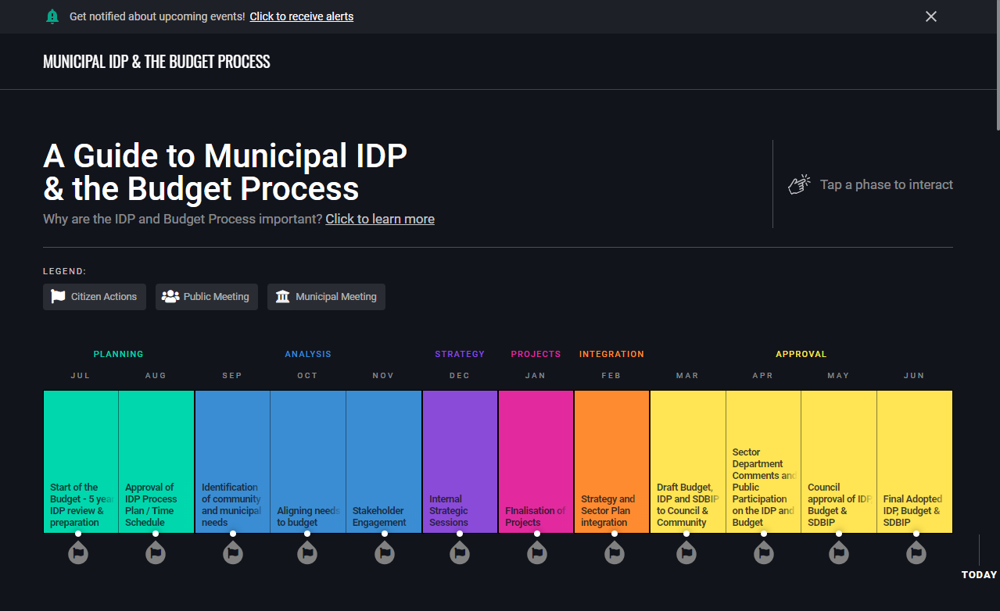
Focusing on the wrong thing
When/Where vs How to participate
People participating in an informed manner
Can prepare feedback understanding draft plans
Know when and where feedback opportunities are
Notes:
Just a quick example of some conversations that came out of one of our recent attempts at bringing testing back into our process.
We’re building this tool to help people understand the local government planning process
We think it looks awesome but realise we’ve done a lot of work without speaking to users, so we start speaking to users.
One of the things that stand out, some people are unable to find when the opportunities for participation are.
We thought we can’t get that information, so we carried on with just unpacking the process. But actually hearing users raise this problem, you have to look at this venn diagram.
There are users who are able to find out when and where opportunities for feedback are
Let’s assume our tool makes it understand the process, and the draft plans, and people can make informed comment that would actually be taken into account, because it speaks to the draft plans and the financial reality of the municipality.
If our tool doesn’t make it easier to find these opportunities, the number of people participating effectively as a result of our tool is actually very few.
Perhaps their input would have been totally ok without our guide, and we could have focused all our effort on making the participation events easier to find.

Slide 60
Losing track of the strategy
Actually, it’s the muni’s tool
Municipality is deploying it
They can provide the data
Notes:
But then we noticed another issue.
The participation events were actually part of the strategy. The idea wasn’t that this ool would just be put online and left there. The idea was that it would be something we would offer to municipalities to make part of their participation efforts. They could embed it on their website, or linked to it.
If a municipality is fundamentally part of where this tool is deployed, we can totally assume that we can get access to that data. Which means the actual participation events should really be part of the tool, and get the appropriate amount of emphasis in the interface.
User testing has not just shown that we were focusing on the wrong place, but also started a discussion that took us back to the strategy that will enable what the users want. That strategy was not handed over properly, which is something we see way too often.

Slide 61
Context: What does OpenUp do?
Our fears?
Key considerations
Tools and approach
Practical: try our approach
Recap
What’s covered
Notes:
Next up, we’re going to try the approach on your projects!

Slide 62
In groups
A group member’s project or idea
Enter some short answers on the workspace
Help each other
Use the questions posed
Let’s try the process!
Notes:
We will assign you to groups and you will get an invitation to join a breakout room with a room number
I will show short URLs for each room’s workspace, which will be a google slide that you can all open and edit collaboratively
Please introduce yourselves, and perhaps give an idea of which roles or considerations you represent in your organisation or your projects.

Slide 63
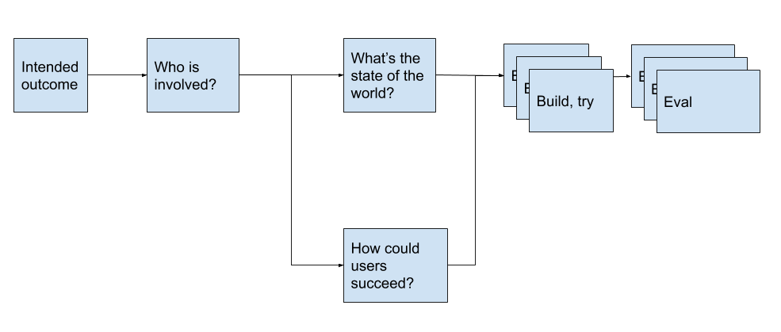
Group n
What data is available? ready to use?
Your project name
What information is out there?
What mechanisms exist?
What is the smallest thing we could do to validate our idea?
What do you understand from what you see here?
What’s the state of the world?
What do we want to achieve?
What is the core of this feature?
What do you not understand from what you see here?
Why do we think our idea will achieve that?
Replace this text: Who is involved in your intervention?
Replace this text: What information and mechanisms exist?
What is wrong? What’s the problem?
What can we leave til later?
What have we misunderstood?
Intended outcome
Who is involved?
Build and try
Evaluate
How could users succeed?
Build and try
Evaluate
Build and try
Evaluate
People should be able ot learn who their politicians are
What motivates your users?
Replace this text: What actions can people take?
What tools do they use?
Replace this text: What might iterations of your intervention look like?
Replace this text: Did you wireframe and test it? Learnings?
What do they know?
How educated are they?
Where are your users located?
How did they find our work?
What are all the steps involved?
Notes:
Use the questions, but also help each other, I’m sure you all have

Slide 64
What stood out most from that exercise?
Did you identify any gaps in your project foundation?
Do you have any new concerns about your project?
Do you have any new confidence in your project?
Are you planning on changing anything?
Group feedback
Notes:
I think the best feedback to get when we rejoin is these questions.
It depends a bit on how much time we have left and how many groups we have - if there’s time we can actually go through your answers to the process chart and then look at these questions

Slide 65
bit.ly/civicproj1a
bit.ly/civicproj1b
bit.ly/civicproj2a
bit.ly/civicproj2b
bit.ly/civicproj2c
bit.ly/civicproj2d
bit.ly/civicproj3a
bit.ly/civicproj3b
Workspace URLs

Slide 66
“
Are we leading people astray?
Any serious mistakes?
Notes:
I would like to hear from you if you think we are seriously misguided, or that we’re leading people away from a good safe path. So during question time, please raise that.

Slide 67
Context: What does OpenUp do?
Our fears?
Key considerations
Tools and approach
Practical: try our approach
Recap
What’s covered

Slide 68
Project definition
Project management
Domain knowledge
Compliance
Track requirements
Administration
Bringing it all together
User experience
Implementation
User research
Medium expertise
Non-tech
Tech
Writing for the user
Creating content
Technical leadership
User testing
Community management
Implementation
Visual design
Notes:
We looked at a lot of important considerations, whether a project has one person or two, someone should probably be thinking of each of these.
Which of these areas are you neglecting? Who can fill that gap? Do you need to bring someone in? Can someone learn a new skill?

Slide 69
This is the essence of Agile
Agile: a set of principles
Scrum: An agile methodology
Minimise risk
Maximise user value
The limitations of humans
Many great tools (procedures, not websites)
Identify assumptions
Agile and Scrum
Help is available
Notes:
There is no new thing under the sun.
I’ve been talking about needs and considerations and roles in a very abstract sense.
You don’t have to invent the actual concrete practises. This is the essence of the standard way of working in the software industry, called agile.
Agile is a set of principles. Derived from the commonalities between projects that were successful?
It does not mean you change direction all the time.
It means you are trying and learning all the time.
Scrum is a methodology for applying the agile principles in your project.
As humans, we tend to be bad at handling the sort of complexity that is common in any software project, but especially in civic technology.
Methodologies like Srum bring tools - procedures and practises - that help deal with our human nature, to identify assumptions, document our decisions, in very easy ways, that don’t add a massive administrative burden.

Slide 70
More control, not less.
Fixed cost
Variable scope
Scope is the thing we don’t understand
Agile and government
Notes:
Agile can work very well with government procurement and projects that need especially tight control.
It’s worth having a clear way of helping administrators and decision makers map the agile way of working to supply chain management processes and oversight.
Being able to talk about the artifacts generated, like minuted decisions made by the client in planning meetings, prioritisation of features by the client, is really helpful in helping people in government understand that the flexibility to adapt scope as you learn, does not mean taking on additional risk.

Slide 71
And learn as much as we can
“
Make the best impact we can with this budget
Recognise that we don’t yet understand
Notes:
One way of doing that, is saying:
Fixed cost, variable scope basically says:
We recognise that we don’t really know exactly what we can achieve
We know which direction we want to go
With this much money available
We’re going to make the best impact we can
We’re going to learn as much as possible

Slide 72
Peter Koen of pondo.co
Jennifer Walker
Code for all
Colleagues
Acknowledgements

Slide 73
Feel free to use this
Licensed under Creative Commons Attribution 4.0 International License.

